Slide 1
Domestic Revenue Mobilization in Ethiopia: Challenges
Wollela A Yesegat
Addis Ababa University

Slide 2
Background
Tax revenue performance
Drivers: Poor revenue performance
Suggestions
Outline

Slide 3
1. Background
The tax structure follows the federal arrangement: assigning revenues to the federal, regional and concurrently to both governments;
Federal and concurrent revenues are administered by federal revenue organs (MoR/CC); regional revenue offices administer regional taxes;
MoF is responsible for tax policy and law drafting (at federal level);
Regional revenue authorities collect about 25% of total tax revenues;

Slide 4
2. Tax revenue performance
Over time, tax revenues increased and reached about ETB 268 billion (about USD 8.9 billion) in 2018/19;
As a share of GDP, tax revenues remain low by many other countries standards;

Slide 5
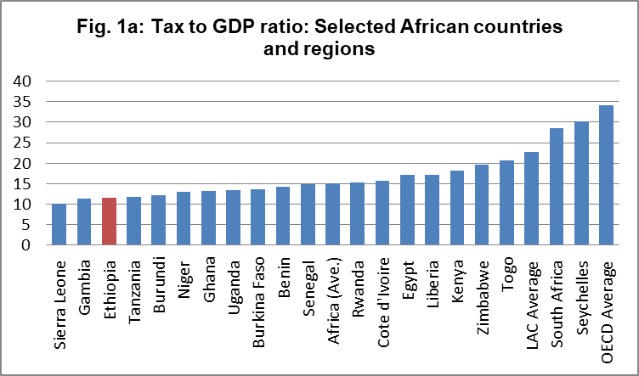
Tax revenue performance (Cont’d)
Over the last decade, tax-GDP ratio reached about 12% (in 2014/15) & continued to decline;
This poor revenue performance contributes to the growing budget deficits and accumulation of public debt.
Budget deficit as a share of GDP increased (-1.6% (2010/11) to -3% (2017/18));
Public debt (external) stock reached USD 26 billion (2017/18); debt to export and debt service to export ratios are high;

Slide 6
3. Drivers: Poor revenue performance
Economic structure and the Informal sector
Dominance of Agriculture: still has a relatively big share - about 33% of GDP in 2018/19;
Informal sector: represents about 38.6% of GDP in Ethiopia;
  34% average in SSA (Adegoke (2019 citing IMF));

Slide 7
Drivers: Poor revenue performance (Cont’d)
Tax policy and administration:
Narrow tax base partly due to:
  various tax concessions granted by the government;
    Recent estimate of TEs is about 5% of GDP;
Limited tax policy and administration capacity
  Tax policy design and law drafting capability – (limited staff number and capability; high staff turnover);
    Tax policy analysis and law drafting is mostly undertaken with external support ;
    There are tax legislation which have been operational for many years without major changes (e.g. VAT/ToT, stamp duty, etc.)
  Tax Data is either nonexistent or poor quality to use for tax policy and administration purposes;
  Limited use of IT solutions in tax administration;
    The administration is mostly manual; electronic taxation introduced in 2012 has not moved much;

Slide 8
Drivers: Poor revenue performance (Cont’d )
Limited coordination and partnership in tax policy and administration
  The relation between MoF&MoR in tax policy and administration remains largely unstructured;
  There is no national level revenue strategy looking at tax policy and administration holistically;
Tax compliance and taxpayer communications:
  Poor taxpayer compliance: fake invoices (under/non-invoicing), manipulation of CRM etc.;
  For example, in 2019, MoR reported about 166 companies using fake invoices (including those without actual transactions –amounting ETB 51 billion);
  IMF estimated VAT compliance gap of 4.1% of GDP (2017/18);
  Limited taxpayer communications and education;

Slide 9
Drivers: Poor revenue performance (Cont’d)
Corruption
  The Media and MoR report about tax officials who are caught while receiving bribes;
  A study also shows that businesses report bribes and irregular payments to be common practices when making tax and custom duty payments in Ethiopia;
5. Political instability and COVID 19 pandemic
  Are likely to impact on normal business operations and contribute to poor collections;

Slide 10
4. Broad suggestions
Broadening tax base through measures including:
  rationalizing and removing unproductive tax expenditure items;
Continuously building staff capacity (tax administration, tax policy design and law drafting);
Increase use of IT solutions in tax administration;
Improve invoicing mechanisms;
Improve taxpayer communication, consultation and education;
Better tax data maintenance and management;
Improve coordination and partnership between MoR-MoF and beyond;

Slide 11
Thank you

